Slide 1
Welcome!

Slide 2


Slide 3
Talk It Over
Think back about a specific area where you’ve grown personally in the past couple of years.
Share the area with those at your table
What motivated you to grow?
What action did you take?
Did others help you? If so, how?

Slide 4
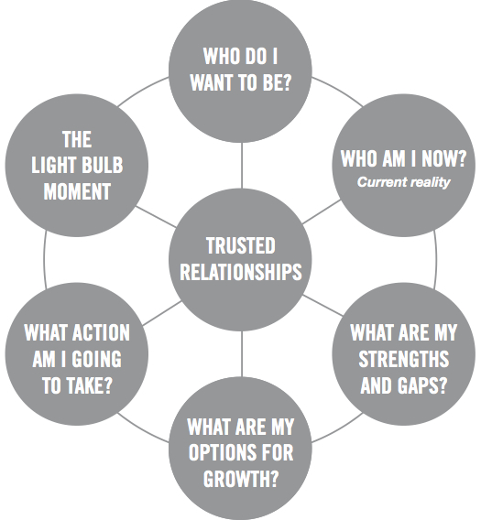
The Personal Growth Process

Slide 5
The Personal Growth Process
People develop best while they are in the game
Personal growth is born out of self-awareness
It is difficult for growth to occur without trusted relationships
People develop when they “own” their growth

Slide 6


Slide 7
What Happens When People Take Ownership?
Q x C = Results

Slide 8
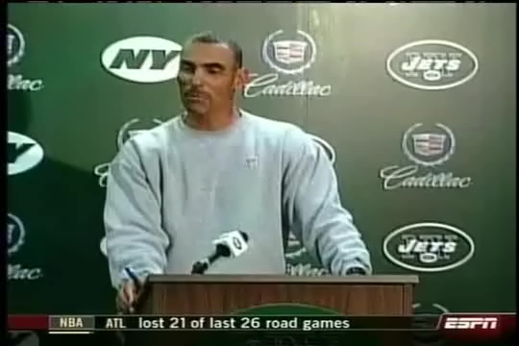

Slide 9
How to Take a
Coaching Approach
These key ideas are
summarized on your laminated card

Slide 10
Common Questions About A Coaching Approach

Slide 11
What is the Probability You’ll Be a Great Leader?
Drive for Results Coaching/Mentoring Your Probability
Strength Weakness
Weakness Strength
Strength Strength
Source: Zenger-Folkman
7%
4%
87%

Slide 12
Different Leadership Styles
Hands Off Collaborative Directive
Delegate & Coach & Control &
Step Away Develop Direct

Slide 13
Common Questions About A Coaching Approach

Slide 14
Establish Rapport and Be Authentic
Great people developers develop a relationship
Great people developers communicate effectively
Great people developers inspire change
Great people developers provide connections

Slide 15
Learn to Recognize Where A Person Is on the Stages of Change
  Six Stages of Change
    Not Ready to Change
    Considering Change
    Preparing to Change
    Taking Action
    Maintaining the Change
    Relapsing

Slide 16
Be Purposeful About Your Conversations
  Four Elements to Include:
    - Goal
    - Reality
    - Options
    - What

Slide 17
Coaching Conversation

Slide 18
Ideas to Get A
Conversation Started

Slide 19
How to Make Your Questions
More Powerful
Ask open-ended questions
Begin broadly and focus increasingly on detail
Seek out and explore discomfort and assumptions

Slide 20
A Kindergarten Point of View
A penny saved is…
Laugh and the whole world laughs with you, cry and…
Children should be seen and not…
You get out of something only what you…
If at first you don’t succeed…
not much.
you have to blow you nose.
spanked or grounded.
see in the picture on the box.
get new batteries.

Slide 21
How to Listen
More Effectively

Slide 22
Coaching Conversation

Slide 23


Slide 24
Coaching Conversation

Slide 25
When to Offer Your Perspective
When the other person has already come up with a few options
When you have relevant experience that the other person does not have
When you have knowledge of tools or resources that may be helpful
When you’ve observed the other person in action and can provide feedback
When the other person asks for your point of view

Slide 26
If You Choose to Offer Your Perspective…
Ask for permission to share your point of view
Offer your thoughts in small doses, and specific
Be intentional not to diminish the other person’s buy-in
If you’ve said everything you wanted to say, you’ve probably said too much

Slide 27
Characteristics of SMART Goals
    Specific
    Measurable
    Attainable
    Relevant
    Time-Bound

Slide 28
Coaching Conversation

Slide 29
Great Job!

